Slide 1
Used cars data.

Slide 2
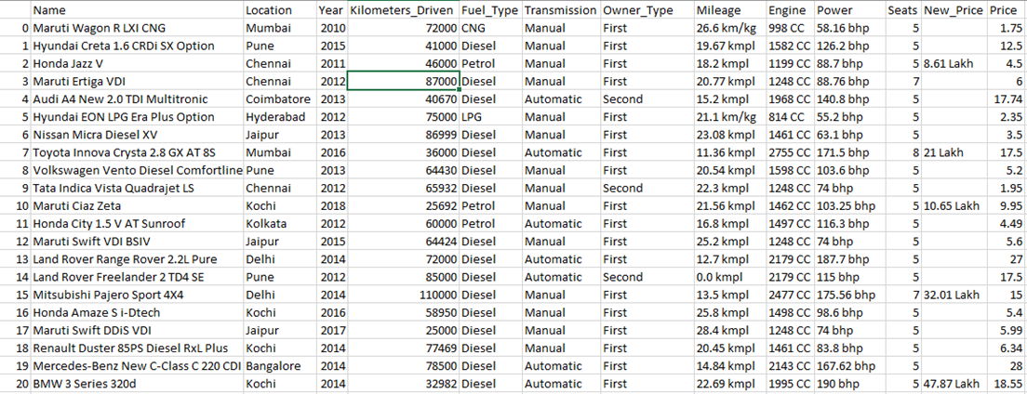
This is the sample from the data we have.

Slide 3
Data understanding
As we can see we have 13 columns which are:
Name of the car.
The Location in which the car is being sold or is available for purchase.
The Year or edition of the model.
The total Kilometres driven in the car by the previous owner(s) in KM.
The Type of fuel used by the car. (Petrol / Diesel / Electric / CNG / LPG).
The type of Transmission used by the car. (Automatic / Manual).
Whether the Ownership is Firsthand, Second hand or other.
Mileage, Engine and Power of the car.
How much Seats does it consist.
New(Current) price of car in the market.
Price at which it was bought.
Data has 13 columns and 6019 rows.

Slide 4
Data cleaning
First thing I did was I ran data.describe(include=’all’) and I found there are alot of missing values in ‘New price’ column i.e. 5195 and some in ‘Mileage’, ‘Engine’, ‘Power’ and ‘Seats’ i.e. 2, 36, 36 and 42 respectively. So I droped the ‘New price’ column and run data.dropna() to delete rows with missing values.
Then I checked data.info() and found that ‘Mileage’, ‘Engine’ and ‘Power’ has value types as Objects because their values were given with the respective units. So I used string.split() method and kept columns which had numbers only and converted them from object to float type with ‘.astype(float)’ method.

Slide 5
Exploratory data analysis.

Slide 6
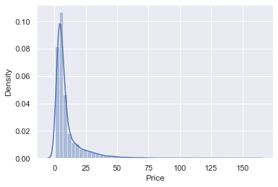
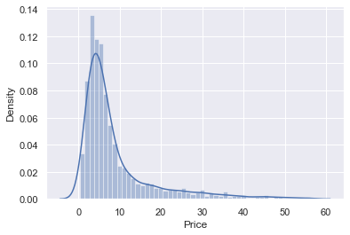
Price:
There were alot of outliers in the feature ‘Price’ which were representing extremely expensive luxury/sports cars so I removed data above 99th quantile. Here are distributions of ‘Price’ feature before and after removing outliers.

Slide 7
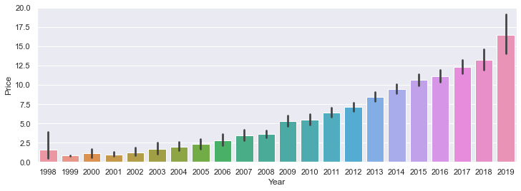
Year vs Price:
Older the car more frequent maintenance it is going to need and we might not even find its parts that easily so they are usually cheaper.

Slide 8
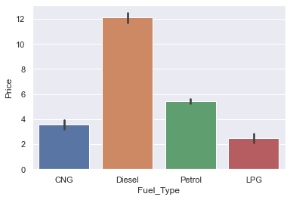
Fuel type vs Price:
As we can see Diesel and Petrol cars are the most expensive one since mostly sports/luxury cars use these 2 types of fuel.
And producing CNG and LPG gases are cheaper than Diesel and petrol. Results in dropping the total cost of car.

Slide 9
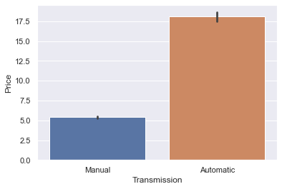
Transmission vs Price:
As we can see manual cars are far more cheaper than automatic ones.
Since automatic cars offer the convenience of cruising through city traffic with ease they are expensive than manual. Also they are costlier to repair.

Slide 10
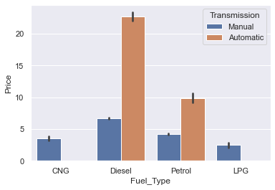
Fuel type vs Price with Transmission as hue:
As we saw earlier most luxury/sports cars use petrol or diesel as fuel are automatic hence we can see the price difference.

Slide 11
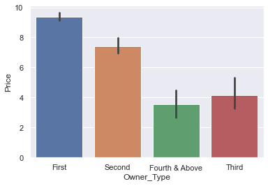
Owner type vs Price:
This is obvious that brand new cars have advantages of its own like:
No need of frequent maintenance and more availability of its parts.
If a car is used, then anyway no one is going to spend the price at which it was originally bought.

Slide 12
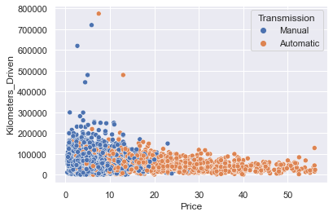
Kilometers it is driven vs
Price:
More kms it is driven more used it is which already makes it excluded from ‘First owner’ category from ‘Owner type’, therefore most of cars are less expensive in the graph.
Automatic cars with same kms driven as manual are expensive as they are most likely to be luxury/sports car or SUVs.
There are 2 automatic cars which are cheap as compared to other automatic cars since they have been driven a lot.

Slide 13
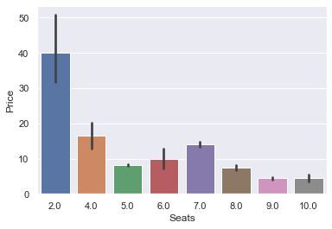
Seats vs Price:
2 seaters cars are usually luxury/sports cars which are lighter and faster with better engine and power.
4 to 7 seaters cars are usually SUV cars which are compact than MPVs and are available in automatic transmission.
And cars which has more than 7 seats are MPVs or Multi purpose vehicles. Mostly used by families who usually prefer more space and cheaper cost.

Slide 14
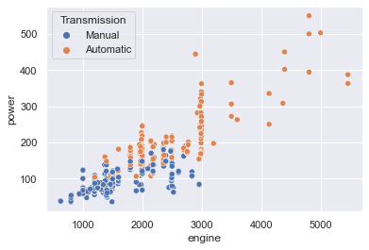
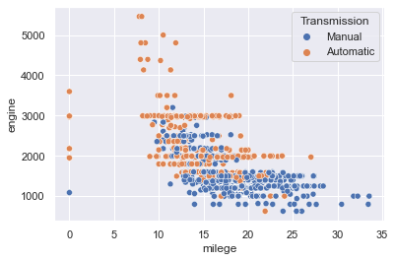
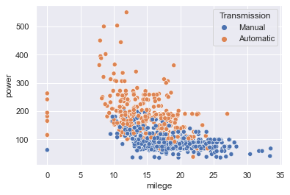
Relationship between Engine, Mileage and Power
Heavier the Engine more power it produces.
More power a car produces less its mileage is going to be.
Also, a heavier engine also affects the mileage of the car.

Slide 15
Engine vs Power
CC in engine stands for Cubic capacity which refers to the volume of a cylinders the engine has which are responsible to produce power.
So more CC means more power the car is going to produce.

Slide 16
Engine vs Mileage
Heavier the engine more it is going to affect the mileage of a car.
Heavier CC engine produces more power causing more consumption of fuel results in lesser mileage.

Slide 17
Mileage vs Power
Horsepower is a major factor in a vehicle's fuel consumption. More power generally means higher fuel consumption.
To produce more power engine runs faster which might heat up the engine which also causes more fuel consumption resulting lesser mileage.

Slide 18
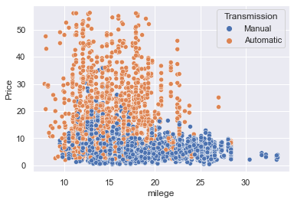
Mileage vs price
As we can see automatic cars with medium level of mileage are expensive. Those are usually luxury/sports cars.
Manual cars are diverse in mileage but still manage to be cheaper.
There are some really cheap Manual cars with high mileage..

Slide 19
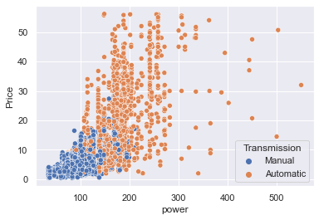
Power vs price
Automatic cars which are more likely to be expensive have more power as compared to Manual.
If a car has less power and is budget friendly to buy it is more likely to be a Manual.
But there are some Automatic cars which has more power and are little less expensive than the most luxury cars.

Slide 20
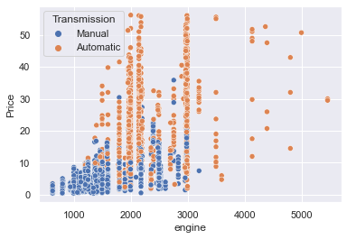
Engine vs price
Heavier the engine expensive the car is going to be.
Even if a car has a engine which weighs certain weight it is going to be expensive if its a Automatic one.
Mostly manual cars have lighter engine since it does not require to be as fast as these sports cars.

Slide 21
Summary:
If the car is automatic and runs on diesel or petrol it is going to cost way more than a manual.
Luxury cars are more compact and have better engines producing more power so they'll be expensive.
The older the car more driven it will be and will be cheaper as compared to others. This will save your money but it will have disadvantages of its own.
Using cars which runs on CNG or LPG and have smaller engine producing enough power for you will give you higher mileage and will save a lot of money also you won't be affecting the environment.

Slide 22
Model building
Now based on the current data we have gone through some operations to build a predictive model:
Make Input and Output variables.
Use train_test_split() to make split data into 80-20 to create train data and test data respectively.
Try multiple models and compare their MSEs.
Do hyperparameter tuning with GridSearchCV() and see if we can increase the accuracy of model and then try it on test data to see how does it perform when introduced to new data.
Then compare different models with each other to see which one gives better accuracy and then that will be our final model.

Slide 23
Compared models.
Here are the results after Hyperparameter tuning:
Model_name | Best_parameters | Best_scores
Linear_model | {'n_jobs': 2} | 0.720175
Decision_tree | {'criterion': 'mae', 'max_depth': 8, 'min_samples_split': 10} | 0.864731
Random_forest | {'criterion': 'mae', 'max_depth': 18, 'n_estimators': 100} | 0.926568
So Random forest will be the final model for this dataset.

Slide 24
Feature values indication:
Features like ‘Year’, ‘Kilometers_driven’, ‘mileage’, ‘engine’ and ‘power’ are supposed to be entered as they are.
In ‘fuel_t’ 0 indicates ‘CNG’, 1 indicates ‘Diesel’, 2 indicates ‘Petrol’ and 3 indicates ‘LPG’.
In ‘transmission’ 0 indicates ‘manual’ and 1 indicates ‘automatic’.
In ‘owner_type’ 0 indicates ‘First’, 1 indicates ‘Second’, 2 indicates ‘Fourth & Above’ and 3 indicates ‘Third’.

Slide 25
Brand and Location feature:
In ‘brand_map’ 0 indicates cheap brands ('Chevrolet','Datsun','Fiat','Tata','Maruti','Nissan','Volkswagen','Hyundai','Honda,Renault','Ford','Skoda','Mahindra','Mitsubishi','Toyota','ISUZU'), 1 indicates medium('Jeep','Volvo', 'Isuzu'), 2 indicates decent brands ('BMW', 'Audi', 'Mercedes-Benz', 'Mini'), 3 indicates expensive brands ('Jaguar', 'Land') and 4 indicates luxury brands ('Porsche', 'Bentley')
In ‘location_encoder’ every city has been allocated with number such as 'Mumbai':0, 'Pune':1, 'Chennai':2, 'Coimbatore':3, 'Hyderabad':4, 'Jaipur':5, 'Kochi':6, 'Kolkata':7, 'Delhi':8, 'Bangalore':9, 'Ahmedabad':10.

Slide 26
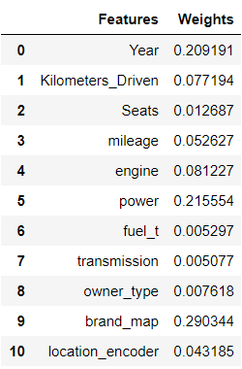
Coefficients of features according to the model:
So as shown before we enter value in model and predict the car’s model.
And these are the respective coefficients of the features.

Slide 27
Thank you.

